Slide 1
Guess that Game
Heldin Parkman

Slide 2
Progression
Once we switched over from using LibGDX to Layouts…
Release | Specs
1.0 | Basic plumbing
2.0 | Functional menu
3.0 | Add a game activity
4.0 | Add radiobuttons, toasts, etc.
5.0 | Add score
6.0 | Add XML
7.0 | Add sound
8.0 | Add more levels

Slide 3
Features
Basic logo quiz
Has functional menus and embedded web page
Scalable
a new system called...buttons
Images

Slide 4
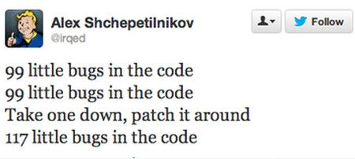
Disclaimer
Answer selection bug
HTML code does not scale
Sound can splay multiple times

Slide 5
Object Overview
To win
Menu
Game
Settings
Web Page

Slide 6
Unique Challenges
Learning how to use layouts
Trying to use xml to store data

Slide 7
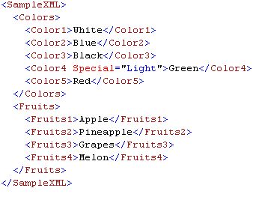
XML Input

Slide 8
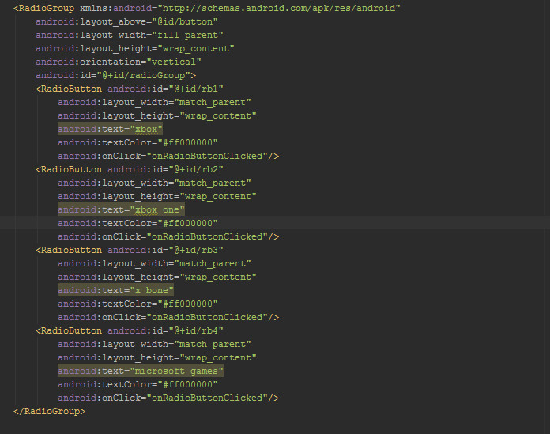

Slide 9
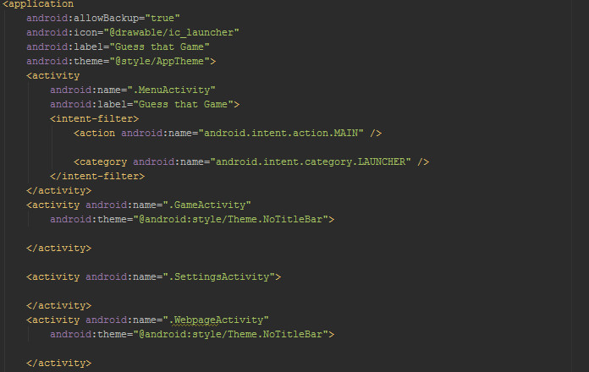
Android Manifest
Where you add activities and choose their properties.

Slide 10
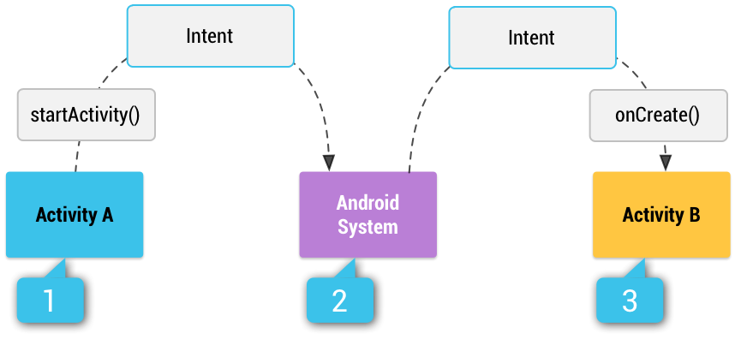
Intents relay actions to be performed and data
Think of them as "messengers" that run between each activity

Slide 11
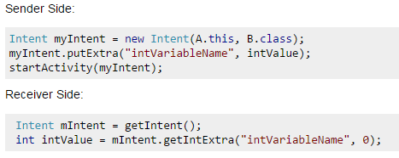
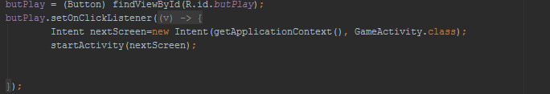
Passing Variables

Slide 12
New Programming Techniques
Layouts
XML
HTML(not made by us)

Slide 13
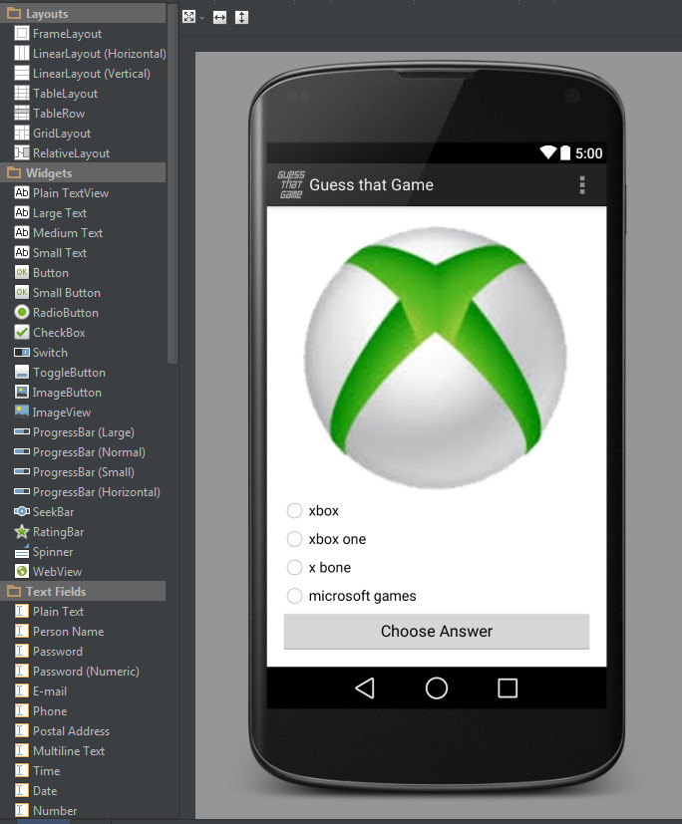
Layouts!
android.makeapp(LogoQuiz);

Slide 14
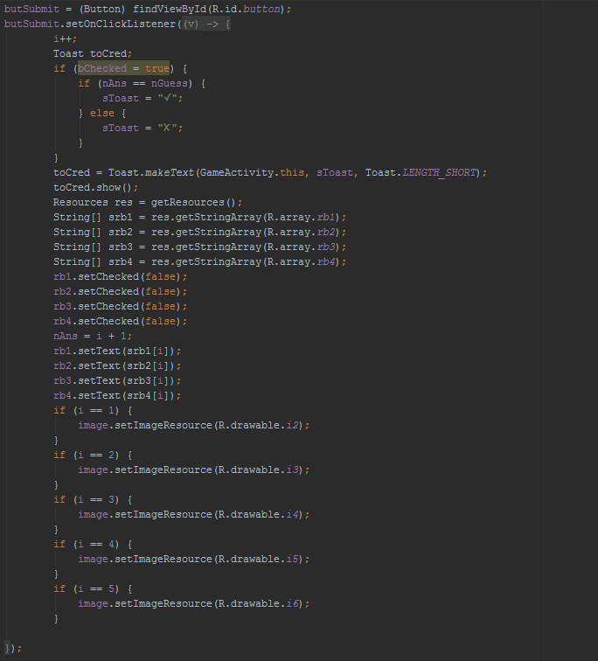
Copy Paste Concept
Currently v2.3

Slide 15
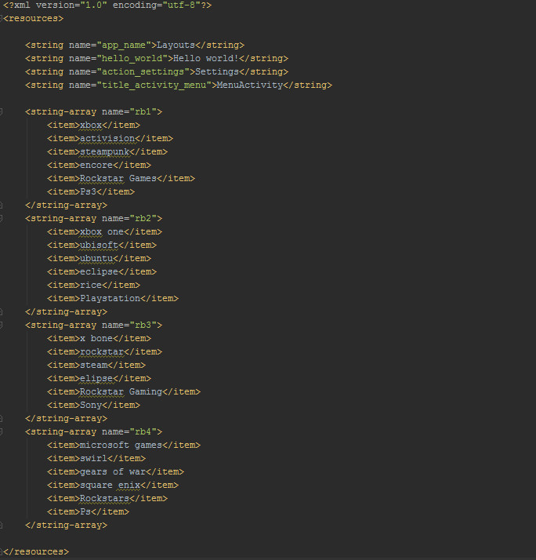
Strings.xml
used to store the names of the logos

Slide 16
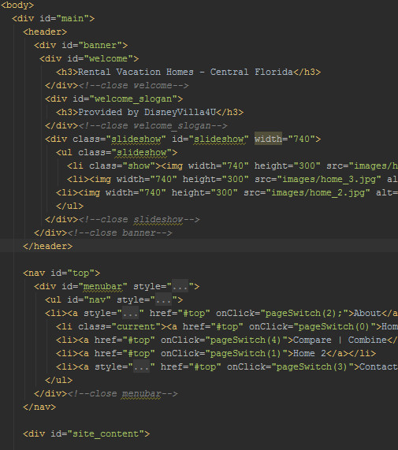
Html that we used
provided by:
Doug Wallbank

Slide 17
Frustrations
Getting up to speed with GitHub
Our Laptops, Austin has fun repairing Windows and Danny has fun in the registry!
Android Studio updates.
Getting Xml to work

Slide 18
Notes to Future Programmers
Learn how to use layouts
Try and connect layouts with something like libGDX.
Keep GitHub organized and learn how to use it properly
When making your spec sheet, don't be too specific, use it to give you direction
Also don't save over your initial specs

